Slide 1




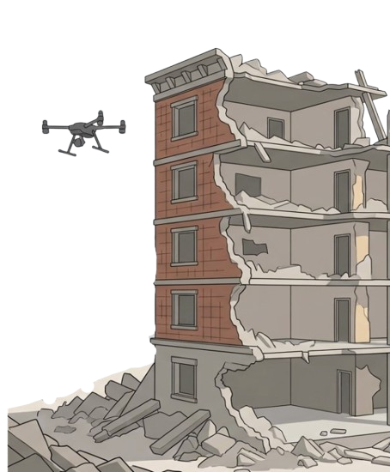

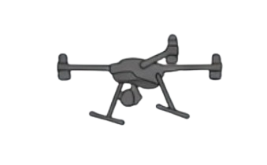
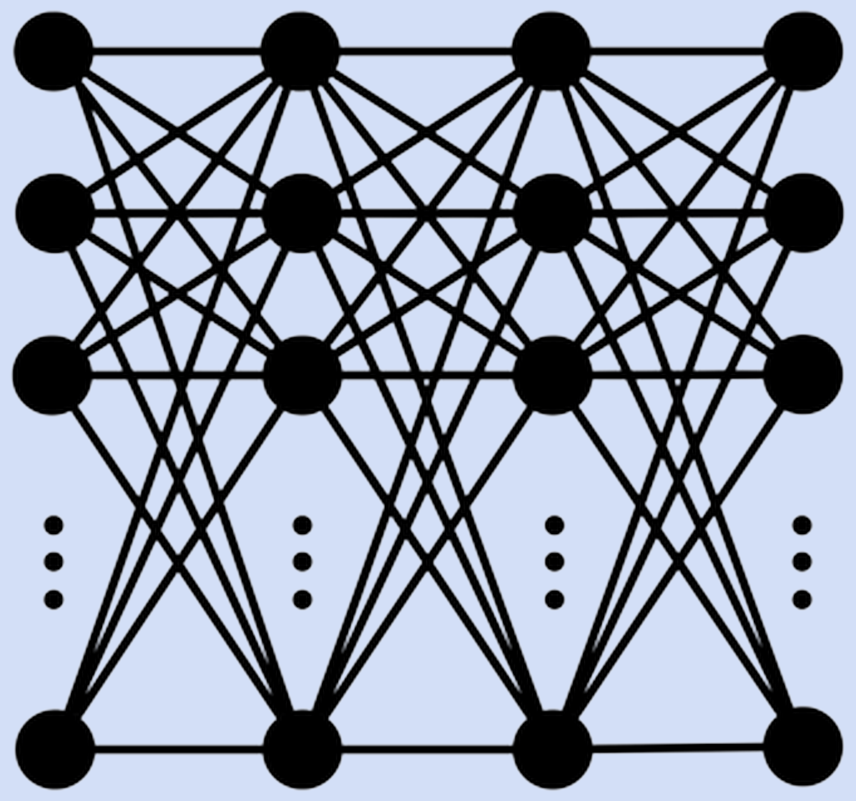

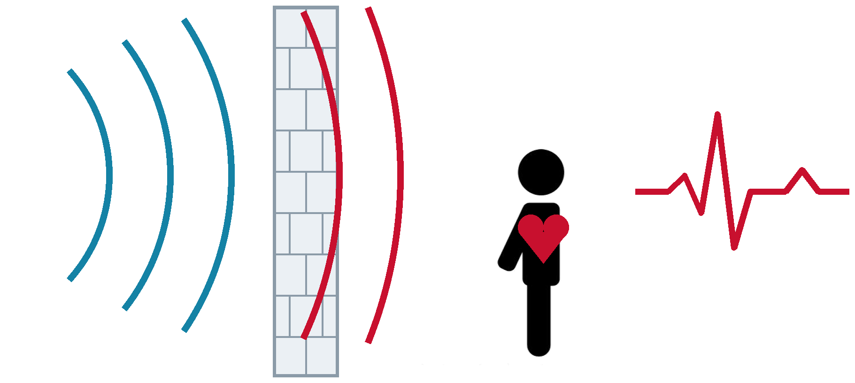
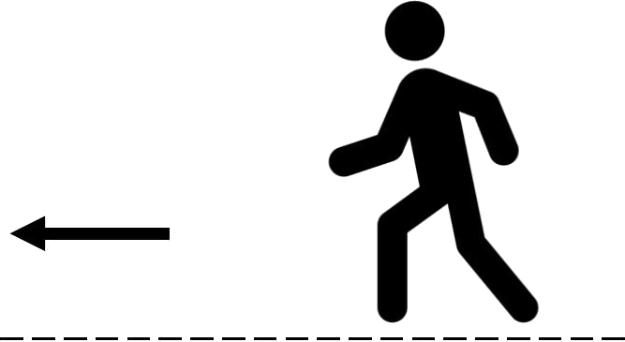
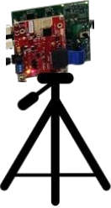

Physics-Aware AI for Adaptive In-Situ Learning in Radar-based ATR
POSTER 2.9
THEME 2
PI: Dr. Sevgi Z. Gurbuz
Sultanus Salehin (Presenter)
Sean Kearney, Kamrul Islam, Muhammad Moiz, Sevgi Z. Gurbuz
Department of Electrical & Computer Engineering, North Carolina State University
Motivation
GRAPHICAL ABSTRACT
Open Set Continual Learning of New Targets
Robust, accurate and power-efficient radar-based automatic target recognition in dynamic environments.
OBJECTIVE
Physics-aware adaptation for high performance in dynamic environments.
DEVELOPED SOLUTIONS
▪ Physics-aware DNN design strategies that lower power consumption and reliance on training data.
▪ Physics-aware continual learning that learns previously unseen targets and their physical characteristics - on the fly.
Registered UAV
RF
PhMTL
for CPL
target class
unknown UAV
P_{est}
target characteristics
No THREAT
new
target?
yes
Establish
new prototype
THREAT ASSESSMENT !
Characteristics
Human = Gait Parameters
Drone = Blade length, wingspan, rotor speed,
# rotors, # blades
CPL = Continuous Prototype Learning
PhyMTL = Physics-aware Multi-task Learning
radar
Unknown target in the field? It becomes a new prototype, not a wrong label.
Physics-based models supply the new target's characteristics and multi-task backbone absorbs the new class without forgetting the old ones.
Human Detection
& Gait/ Injury Recognition
Heart Rate
Monitoring
IMPACT? Every unknown target makes the radar better at the next one.
COUNTER-UAS
DISASTER RESPONSE
Through-the-wall Human Sensing for Disaster Response
Human skeleton estimation · no prior real data !!
Heart-rate extraction · under random body motion
Physics-Based
Reconstruction
^
PERFORMANCE vs STATE OF THE ART
RF Data
RF Data
20×
less energy per inference
35.7 J vs 711.8 J (A-VMD)
Loss_{Physics}
19×
faster per decision
0.88 s vs 17.07 s (A-VMD)
Current methods require optical Ground Truth
Our approach requires no prior real data and learns in-situ from radar data only with greater accuracy.
Through a wall, a trapped survivor never stays still, and the movement overpowers the heartbeat.
The skeleton tells us how the body moved, so we remove it and estimate what is left- Which is the person’s heart rate.
29%
lower skeleton error
from the physics-aware loss alone
IMPACT? No ground truth exists inside a collapsed building – so our model estimate human skeleton in-situ
IMPACT? Faster and more power efficient than the state of the art - and it works while the body moves.

